Slide 1

Detection of mycotoxins in dry fig using NIR scan with AI-based methods
Emre Öztürk
Approved by İpek Baz
Faculty of Engineering
Department of Electrical and Electronics Engineering
Istanbul, 2024

Slide 2

Welcome Message
Hello and welcome,
Today, we have gathered here to present my thesis and I would like to thank everyone for their attendance and support, especially Professor İpek Baz. I hope you will follow my presentation with interest and find it useful. Now, with your permission, I would like to begin my presentation.
Thank you.

Slide 3
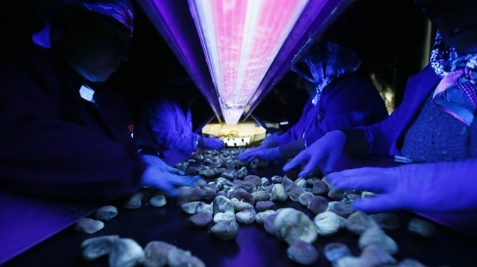
Detection of mycotoxins in dry fig using NIR scan with AI-based methods
Abstract
Aflatoxins are highly dangerous toxic byproducts produced by certain types of fungi. Various food products, especially dried figs, can become infected and lead to various complications, posing a serious problem for human and animal health. Currently, the detection of figs carrying aflatoxin risk in fig production facilities is done manually. Prolonged exposure to aflatoxin detected with UV light poses health risks. Moreover, ensuring accurate aflatoxin detection requires considering human error.
The aim of this study is to collect data on aflatoxin-contaminated and healthy figs using an NIR scan measurement device and to develop an artificial intelligence-based solution for the accurate classification of aflatoxin-contaminated and healthy figs.
In summary, the goal is to provide a safer and more effective alternative to existing methods in dried fig processing facilities.
Introduction
Due to its high sugar content and the structure of its skin, which facilitates the penetration of aflatoxins, dried fig is particularly susceptible to aflatoxin contamination. Levels of contamination can be worryingly high, posing significant health risks.
The detection and quantification of aflatoxins typically involve costly and time-consuming methods such as liquid chromatography (LC) and high-performance liquid chromatography (HPLC), despite their accuracy. Immunological methods like ELISA offer faster alternatives, but they come with accuracy and cross-reactivity issues.
The need for non-destructive, rapid, and accurate detection methods is increasing. Techniques like near-infrared spectroscopy (NIR) hold promise due to their speed and sensitivity. Operating in the 900-1800 nm range. NIR is suitable for detecting aflatoxin contamination in dried figs and providing reliable and safe data without requiring extensive sample preparation.

Slide 4
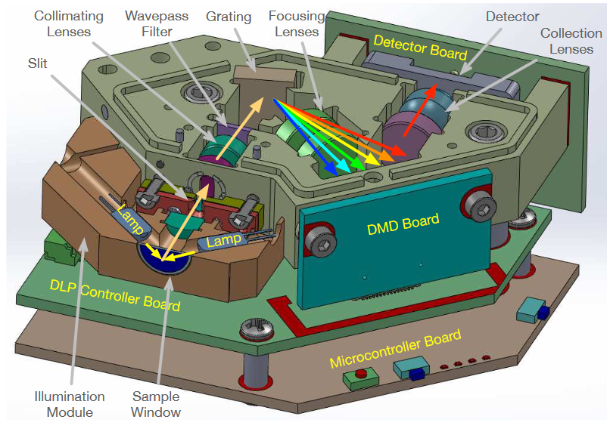
Information About Near-Infrared Spectroscopy
NIR devices utilize spectroscopy to analyze the chemical composition of objects using light in the near-infrared (NIR) region (700 nm - 2500 nm wavelength range). Spectroscopy works by examining how an object absorbs or reflects light at different wavelengths.
Initially, the product is placed in the sample window and illuminated using lamps. The light passing through the slit encounters Collimating lenses first, which make the incoming light parallel, thus organizing the distribution in the optical system. Then, the light at specific wavelengths passes through a Wavepass Filter. Additionally, it is ensured that visible light is removed, focusing on infrared light.
The light is dispersed into wavelengths using a grating. With the Focusing lens, the light is focused on a specific point, and the focused light reaching the DMD allows the light to be reflected in desired directions using micro-mirrors. The scattered light is collected and focused on a point using a Collection lens. The light signals are converted into electrical signals by the Detector. The type of detector used is typically InGaAs, utilized for detecting light in the near-infrared spectrum regions.

Slide 5
Literature Review
According to a study conducted by Güneş et al. in 2013, aflatoxin contamination in dried figs was detected with over 90% accuracy using reflectance values ​​between NIR 780 nm and 2500 nm. and Linear Discriminant Classifier (LDC) and Logarithmic Linear Classifier (LOGLC) methods were applied. However, using wavelengths between 780 and 2500 nanometers allows for the analysis of a wide range of components or properties, but acquiring the entire spectrum may take a long time, which could reduce effectiveness in practical applications and may not be suitable for real-time sorting operations.
NIR spectroscopy has found extensive applications in food research due to its capability to capture spectral bands containing vital information about food content. Compared to multispectral imaging in machine vision, NIR spectroscopy provides more accurate hyperspectral data on food products. In fact, there are numerous recent studies investigating NIR spectroscopy methods for food inspection purposes.

Slide 6
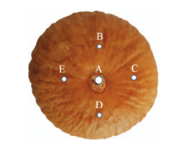
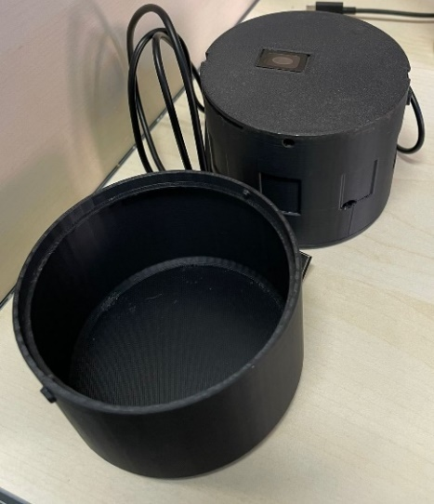
Goals And Objectives
Preparation of the Dataset
İpek Baz provided 1.5 kg of fig samples for experiments: 0.5 kg contaminated with aflatoxin and 1 kg healthy. Experts divided the samples into two groups based on UV light: aflatoxin-contaminated and healthy. 14 aflatoxin-contaminated and 25 healthy figs were measured. Fifty spectral data points were taken from each side of the aflatoxin-contaminated figs, and 28 spectral data points were taken from different points on each side of the healthy figs. In total, there are 1400 data points: representing 700 aflatoxin-contaminated and 700 healthy figs.
Options for NIR
It was tested with various parameters, including resolutions of 228 and 352 and scan numbers of 20 and 40. It was observed that the best result was obtained with 20 epochs and 228 resolution. Trials were conducted with white and black backgrounds during measurements with the NIR device. However, it was observed that the reflected light or ambient light in the room hindered obtaining accurate results during measurements. Therefore, the inappropriate measurement environments also posed a problem. To address this issue, a special box design was used.

Slide 7
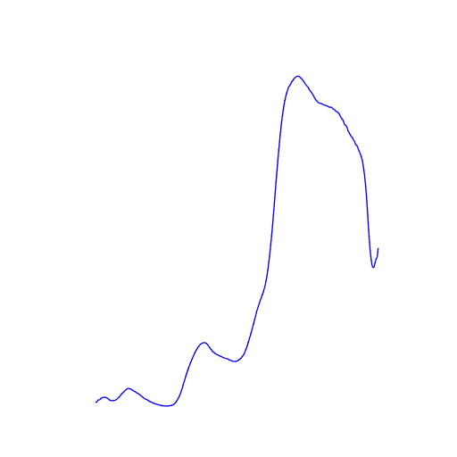
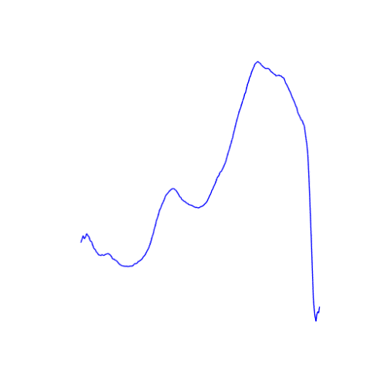
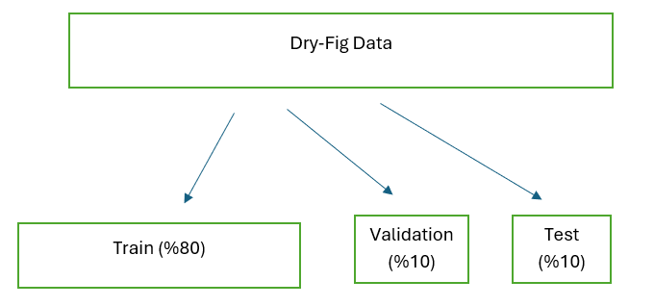
Goals And Objectives
Spectroscopic Measurements
After a comprehensive review of the literature and experiments, it was determined that the spectrometer wavelength range of the DLP NIR scanning nano measurement device is between 900-1800 nm. Spectral data were found to be recorded in three different formats: absorbance, reflactance, and intensity. Subsequently, the most effective classification for dried figs was achieved using absorption values.
Training of Deep Learning Models
The spectral data collected with the NIR device were converted into .png images through appropriate procedures. Each image represents the absorption of light at different wavelengths. Pre-processing steps such as normalization and resizing were applied to the obtained .png images. Additionally, data augmentation was performed.
Eighty percent of the collected data were allocated for training, 10% for validation, and the remaining 10% for testing. The parameters, layers, hyperparameters, and optimizer configurations of the model were optimized for the best performance.
Dried Figs with Aflatoxin Absorbance graph
Healthy Dried Figs with Absorbance graph
7
7

Slide 8
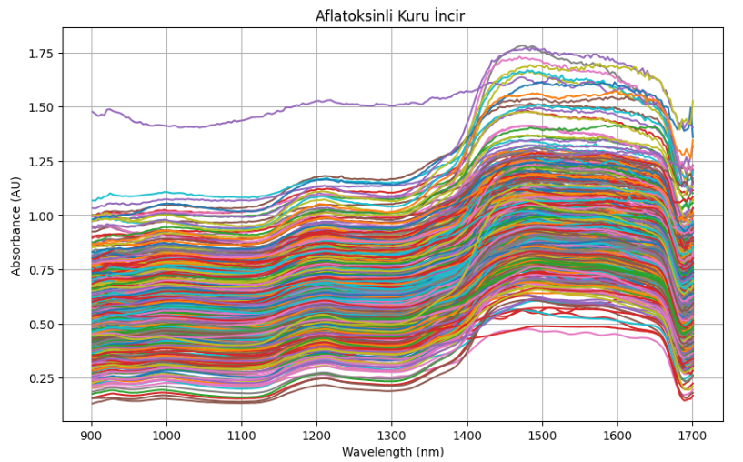
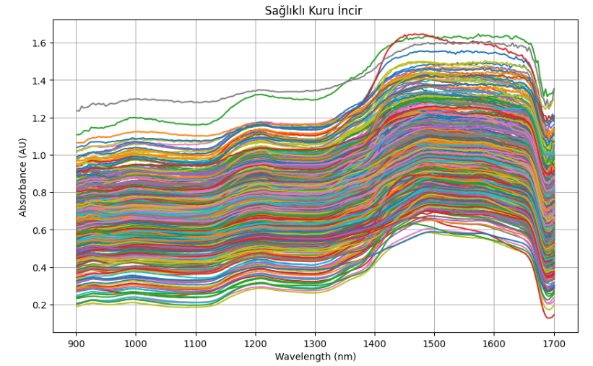
Goals And Objectives
As seen in the graphs below, the absorbance values of 500 aflatoxin-contaminated and 500 healthy dried figs are shown.

Slide 9
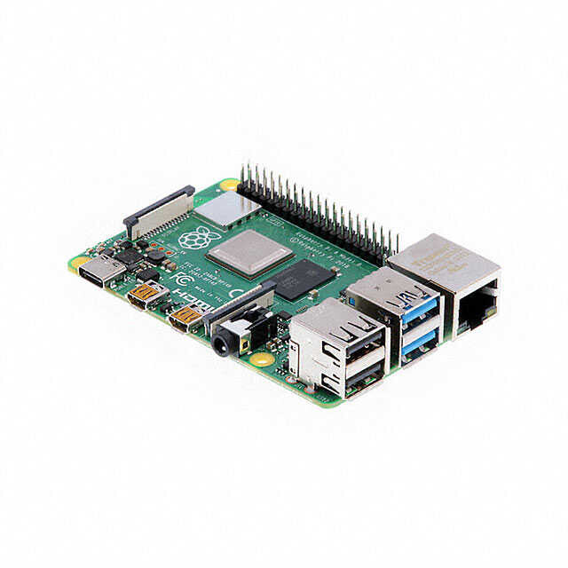
Goals And Objectives
Integration and Testing on Raspberry Pi
The trained models were saved as H5 files. These files were executed on a Raspberry Pi, which will automatically classify healthy and aflatoxin-contaminated dried figs and produce results accordingly. The goal is to connect the saved and trained model to the Raspberry Pi with all its parameters intact, thus enabling it to function and produce results.
9

Slide 10
TIME LINE
Litareture Research
A extensive literature review was conducted.
Algorithm Selection and Design
Deep learning is the extraction of features from a large amount of labeled data using multi-layered neural networks in the context of visual processing. CNNs constitute the fundamental building blocks of deep learning and provide high classification accuracy.
Beginning the Code
In this project, a CNN-based model was built from scratch. All settings, parameters, and hyperparameters have been adjusted, and through various experiments, the most optimal result has been selected.
Experiment and Thesis Phase
After various measurement conditions were selected based on various experiments, and after extensive research and trials, the best model was obtanied, and the thesis writing process began.
Final Report Delivery
Following various feedback from İpek Baz, the thesis was finalized and submitted.

Slide 11


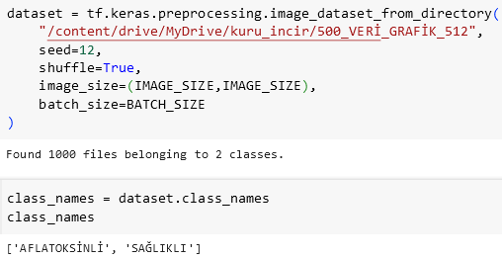
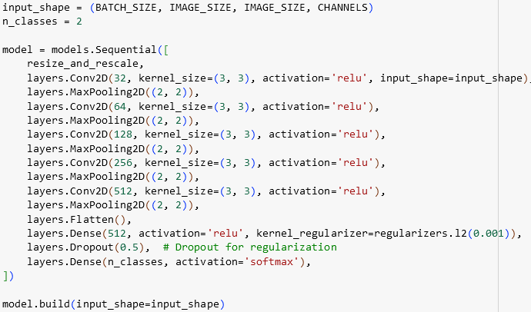

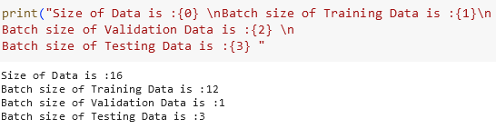

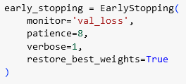

THE CODE

Slide 12
A CNN-based model was created from scratch, and extensive work was done to enhance its quality by adding numerous parameters, hyperparameters, optimizers, and layers.
Hyperparameter
Pre-process
Later, when the learning rate value was decreased from 0.0001 to 0.00001, the training time of the model increased, and the loss graph became smoother.
Data augmentation techniques were tried to prevent the model from overfitting, and good results were achieved by only adding brightness.
Regularization
Optimizer
Additionally, an L2 regularizer was added to the layer to prevent overfitting and enable the model to generalize.
To facilitate rapid and effective training, the "Adam" optimizer was preferred and added.
During training, the data was normalized, but there was no normalization during the testing phase. Normalization was also added during the testing phase, but the result was not as expected.
Initially, when the batch size value was increased from 32 to 64, a significant decrease in validation loss was observed.
Additionally, the model's generalization ability was enhanced by adding a Dropout layer. During training, different neurons are deactivated in each iteration, making the model more robust and flexible.
The resizing layer resizes incoming images to a specific dimension, while the rescaling layer scales pixel values to the [0,1] range.
Different image sizes were tested, and it was observed that the optimal result was achieved with a size of 512x512 pixels.
Different epoch values were tested, and it was determined that using 300 epochs was most appropriate.
Problem Solving

Slide 13
Reach Goals
01
Aim of the Project
This study aims to present an innovative approach for the automatic classification of healthy and contaminated products in the agricultural sector, with the goal of enhancing product quality and reducing human intervention. Also, this project is to construct a system that accurately classifies healthy and aflatoxin-contaminated figs by accurately implementing these steps.
02
Goal achieved
This study demonstrates the successful development of a system capable of accurately, quickly and reliably classifying healthy and aflatoxin-contaminated figs.
14

Slide 14
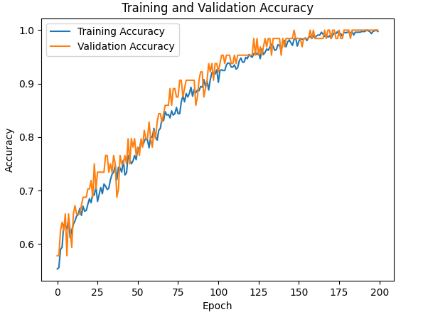
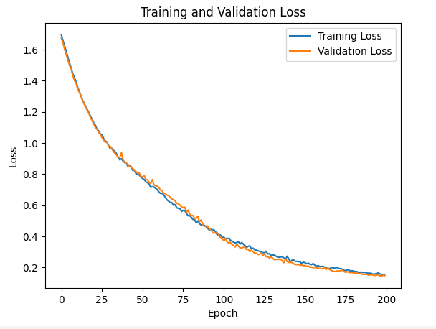
CONCLUSION
During training, the loss consistently decreases while accuracy increases. Validation accuracy generally increases as well, with minimal fluctuations in some epochs. The loss and validation loss graphs exhibit simultaneous, smooth, and regular declines. In the accuracy graph, spikes were observed because the initial weight values of the model are randomly selected. Also, randomly selected data during the training process causes such spikes. The best-performing model achieved a training accuracy of %97.79 and a loss value of %20.05.

Slide 15
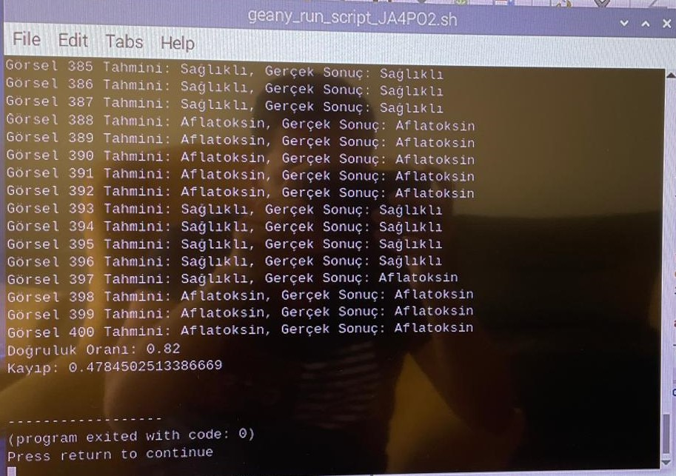
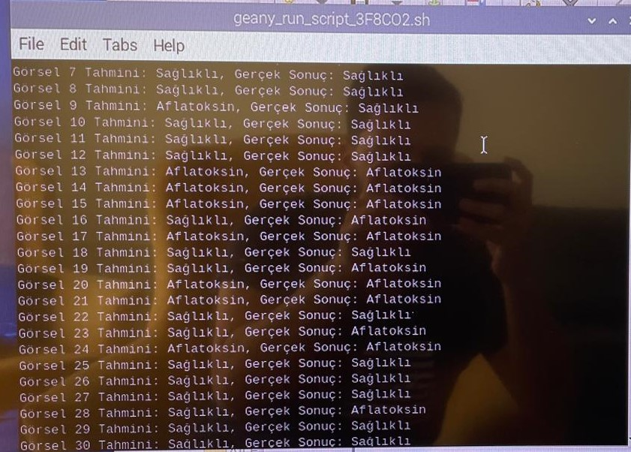

CONCLUSION
The model was tested in both the Colab environment and on a Raspberry Pi using 400 unseen data points, saved as an H5 file. The accuracy rate was determined to be 82%, with a loss value of 0.48%.

Slide 16
CONCLUSION
The training results of the model yielded a 97.79% accuracy rate and a loss value of %0.2005. However, during testing, the accuracy rate was found to be 82%, with a loss value of 0.48%. Although the accuracy is high, the loss is slightly higher than desired. This discrepancy could be attributed to the inadequacy of the environment where measurements were taken and the box designed for the measurement device. The accuracy and loss rates obtained shed light on the success of the project and serve as a guiding beacon for future researchers in this field. Also, this may occur due to similarity between two classes. Despite challenges, the model was successfully classifies healthy and aflatoxin-contaminated dried figs with a high accuracy rate.

Slide 17

Future Work
01
Real-Time Attempts
The only missing part of the project was the absence of a real-time test. Real-time experiments are planned to be conducted in the future.
02
Cons of the NIR
The NIR device is a fast and accurate detection tool, but it is also a sensitive device. Therefore, data collected in a more ideal environment will yield better results.
18

Slide 18
Thank You For Listening

